Slide 1
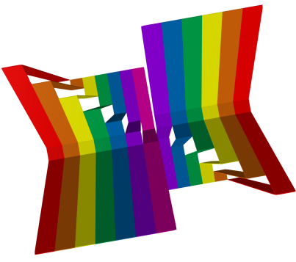
The Swearing Graph
@mickybullock
MathsJam 2012

Slide 2
